Slide 1
Developer Track
119th OGC Member Meeting
Virtual | 16th June 2021

Slide 2
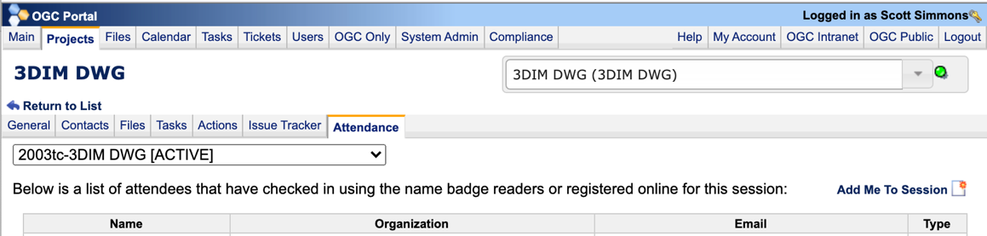
Members: please record your attendance
1. Find the appropriate project
2. Go to the Attendance tab
3. Add yourself to the session

Slide 3
Introduction
Goal
To provide developers with exposure to draft OGC APIs and to share productivity advice about implementing the APIs.
Vision
Held quarterly during each OGC Member Meeting
A single track in the near-to-mid term
Potentially a double track in the long-term
Focus on different OGC standards each time

Slide 4
Focus of today’s Developer Track
GeoPose
OGC API – Coverages
OGC API – Routes
OGC API – Discrete Global Grid Systems (DGGS)
OGC API - Processes [Relevant to Coverages and Routes APIs]
Notes:
OGC API - Processes is used by aspects/extensions of OGC API - Routes and OGC API - Coverages.

Slide 5
Agenda
10:00 - 10:05 Welcome Remarks
10:05 - 10:10 Program for the day and Ways of Working
10:10 - 10:30 Status of GeoPose presented by Steve Smyth (OpenSite Plan)
10:30 - 10:50 Status of OGC API – Coverages presented by Stephan Meißl (EOX) and Jérôme Jacovella-St-Louis (Ecere Corporation)
10:50 - 11:10 Status of OGC API – Routes presented by Jeff Harrison (AGC) and Others
11:10 - 11:30 Status of OGC API – Discrete Global Grid Systems (DGGS) presented by Robert Gibb (Landcare Research New Zealand) & Matt Purss (Pangaea Innovations)
11:30 - 11:45 Break
11:45 - 13:15 Practical work - Block 1: An update on OGC API - Processes
13:15 - 14:45 Practical work - Block 2: JSON Schema for OGC API - DGGS
14:45 - 16:15 Practical work - Block 3: Getting Acquainted with GeoPose
16:15 - 16:30 Break
16:30 - 17:30 Demonstrations
17:30 - 17:50 Discussion
17:50 - 18:00 Wrap up and Close

Slide 6
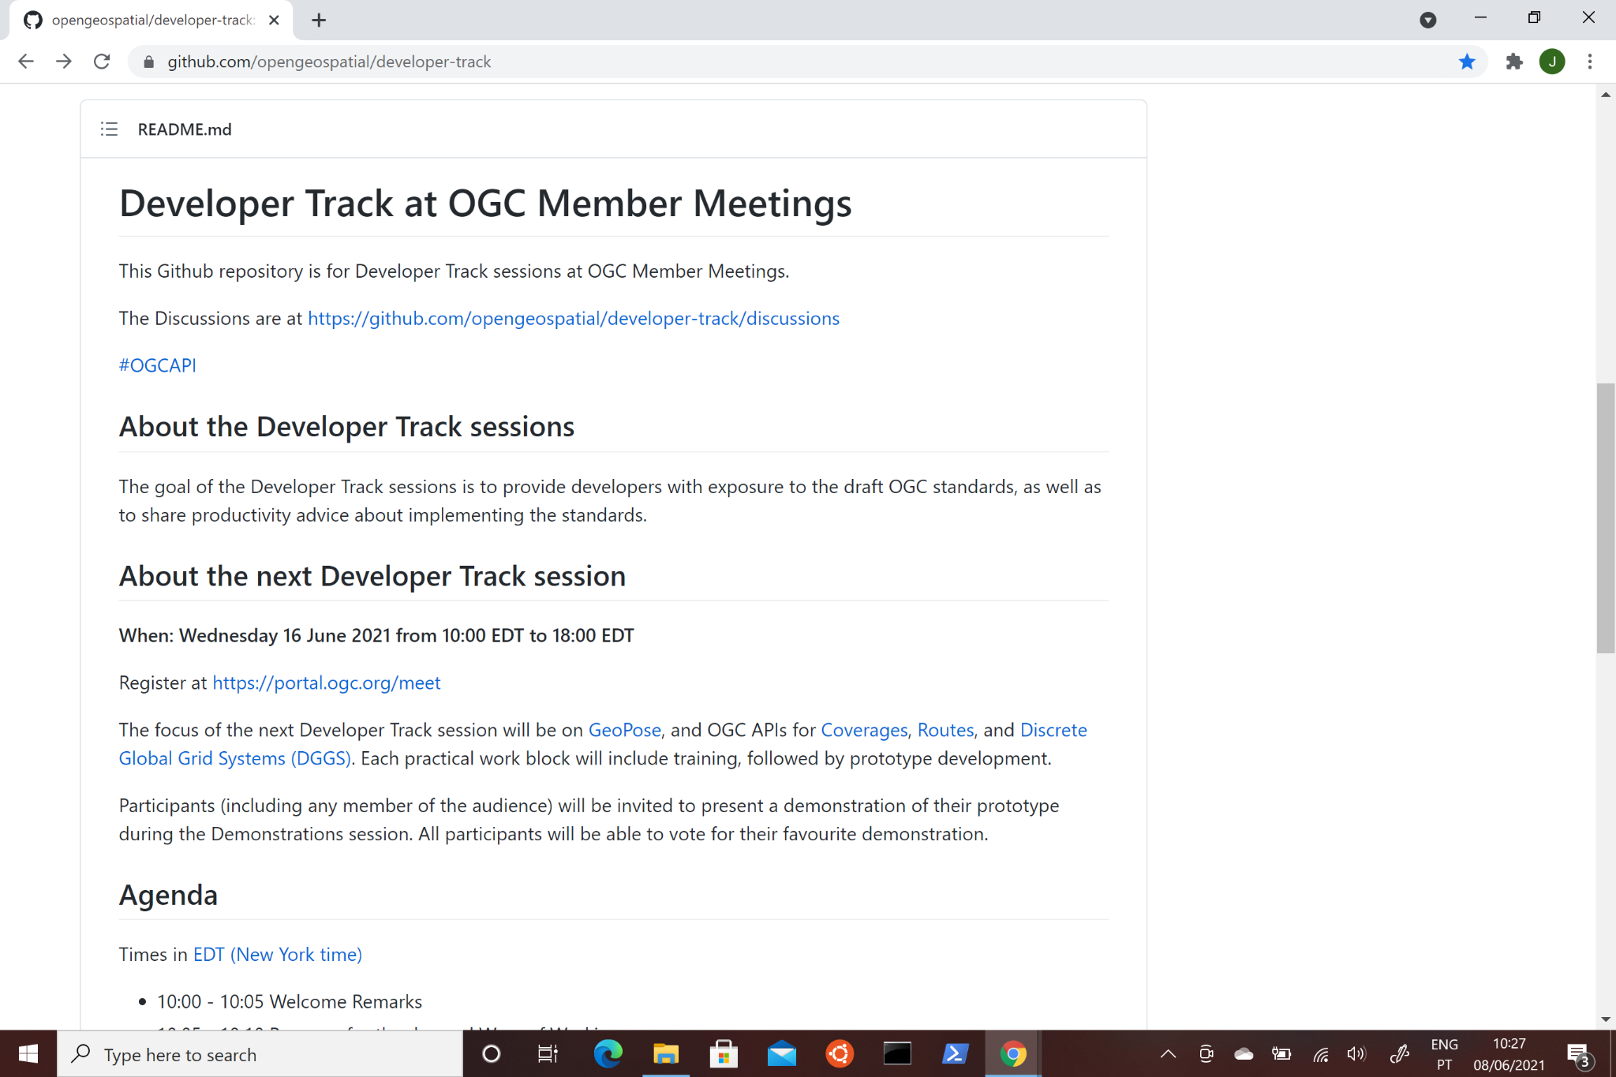
GitHub repository
https://github.com/opengeospatial/developer-track

Slide 7
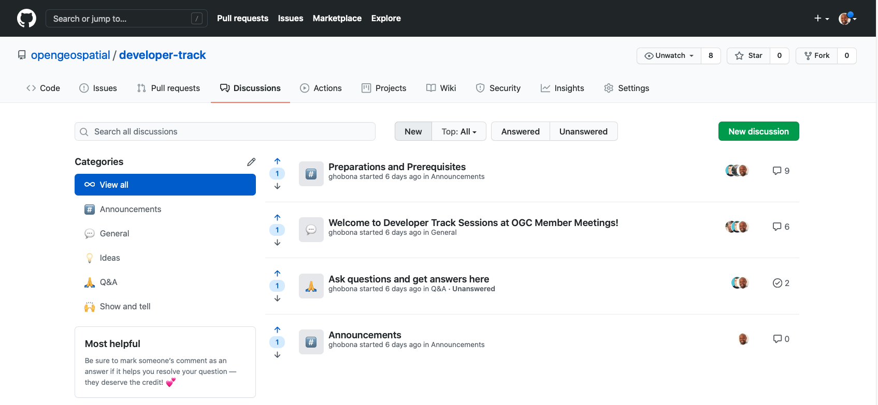
‘Watch’ the GitHub repository

Slide 8
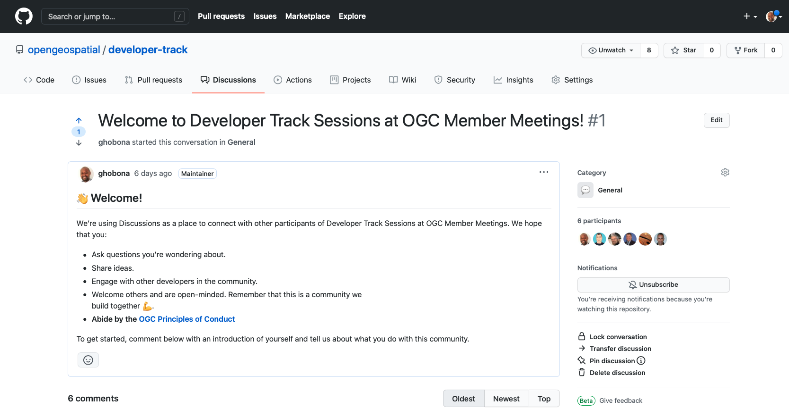
Check that you are subscribed for Notifications

Slide 9
Demonstrations
Participants (including any member of the audience) will be invited to present a demonstration of their prototype during the Demonstrations session.
All participants will be able to vote for their favorite demonstration.

Slide 10

Thank you!

